Slide 1
RESUME CLASSIFICATION
TEAM MEMBERS
Mrs. Archana rakeshkumar Parmar
Ms. Ankita Karamchand Loya
Ms Rutuja Nivrutti Khairnar
Mr Adith Naren kadadi
Mr. Sunnyraj Dadaji Aher
Mentor :- Priyanka

Slide 2
Business Objective
Business objective- The document classification solution should significantly reduce the manual human effort in the HRM. It should achieve a higher level of accuracy and automation with minimal human intervention Sample Data Set Details: Resumes and financial documents

Slide 3
Why Resume Classification ?
1. Your resume summarizes your professional experience, skills and education.
2.When formatting a resume, it’s helpful to include the most pertinent information in categories that make the document easy to scan and review.
3.A hiring manager often receives many resumes for a single open position, so having a well-formatted resume with the proper categories can help you stand out and allows the reviewer to decide whether you are a good fit for the job.

Slide 4
Project Pipeline
Collection of Data
Business Understanding
Exploratory Data Analysis(EDA)
Deployment
Model Evaluation
Model Building

Slide 5
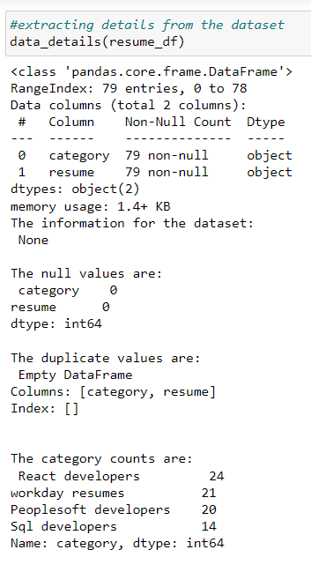
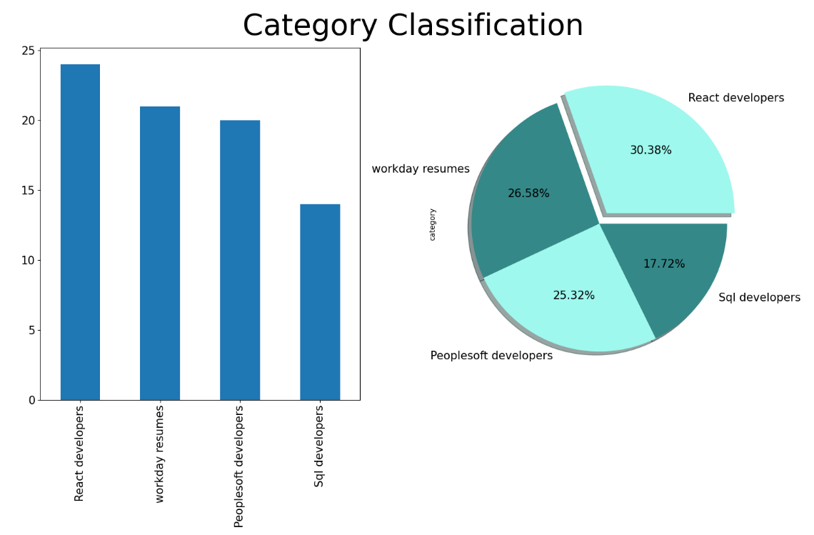
Data Set Details

Slide 6
EDA AND TEXT-PREPROCESSING
DATA CLEANING
Applied Word-Tokenization on each element of all resumes, Removing Punctuation, Removing stop words, Lowering letters of corpus, Applied Stemming, Applied Lemmatization.
TOKENIZATION ON FILTERED RESUME
tokenizes the 'filtered resume' column of the resume Data Frame, splitting each resume into a list of individual tokens
LEMMATIZATION ON FILTERED RESUME
WordNetLemmatizer used for lemmatizing words in English. that provides semantic relationships between words in various languages.
APPLYING COUNT VECTORIZER
CountVectorizer is a text feature extraction technique that converts a collection of text documents into a matrix of token counts. CountVectorizer instance 'cv' to fit the vectorizer to the lemmatized resumes and transform the data into a matrix representation.
APPLYING COUNT VECTORIZER ON N-GRAM
fits the CountVectorizer to the lemmatized resumes, considering unigrams, bigrams, and trigrams as tokens. It then transforms the lemmatized data into a s matrix representation 'bow-matrix-range', where each row represents a resume, and each column represents a unique token (unigram, bigram, or trigram)

Slide 7
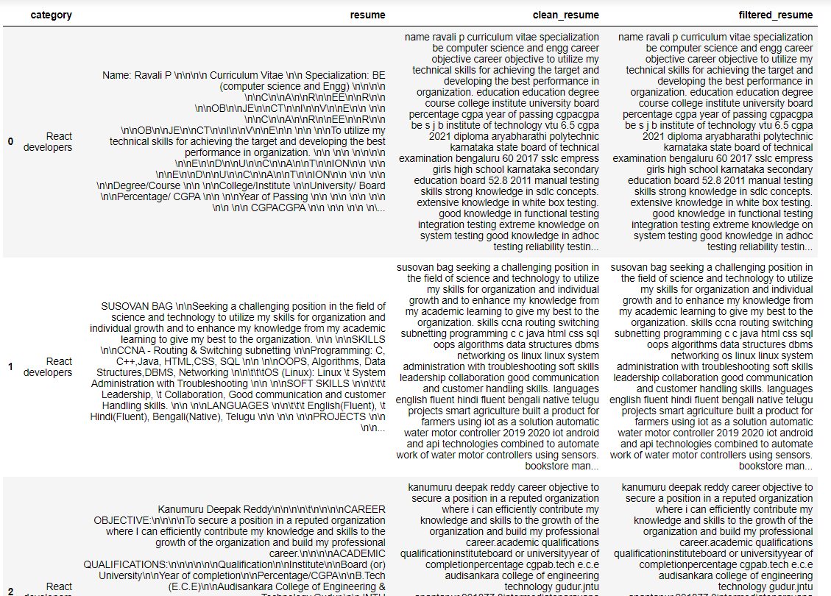
DATA AFTER PREPROCESSING

Slide 8
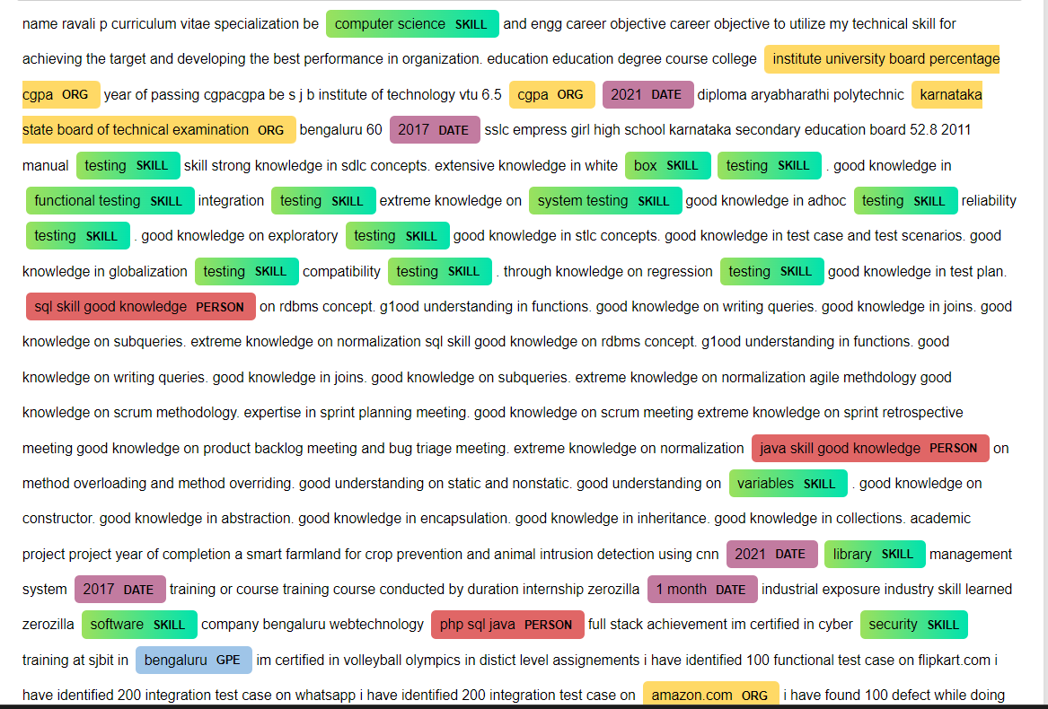
Named entity Recognition (NER)

Slide 9
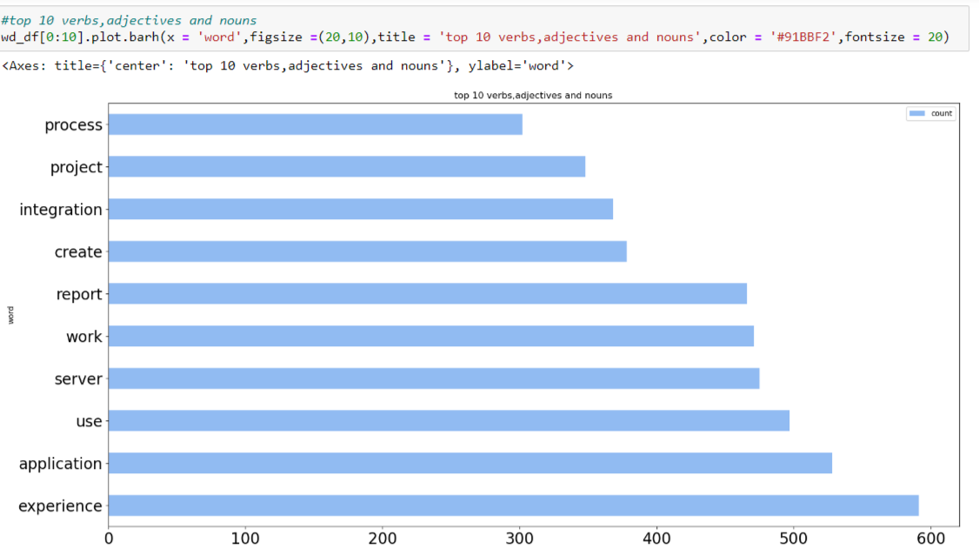
Top 10 Words From Corpus

Slide 10
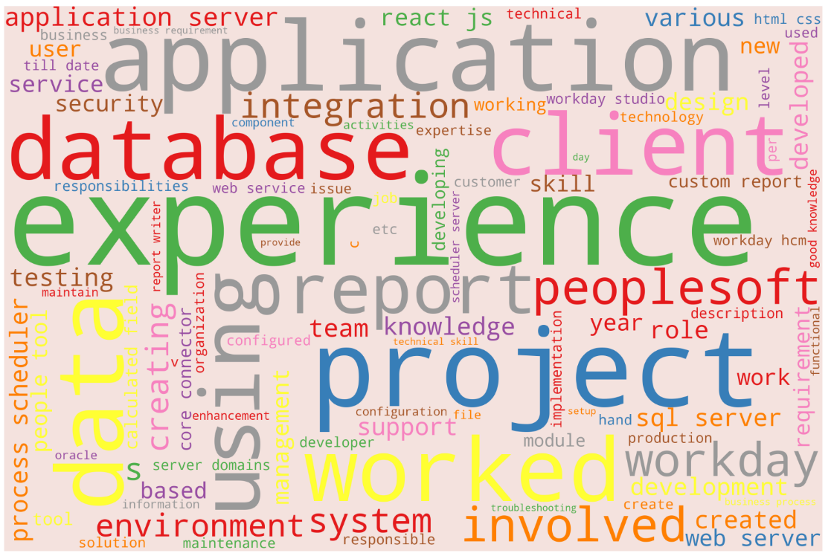
Word cloud with clean sentences

Slide 11
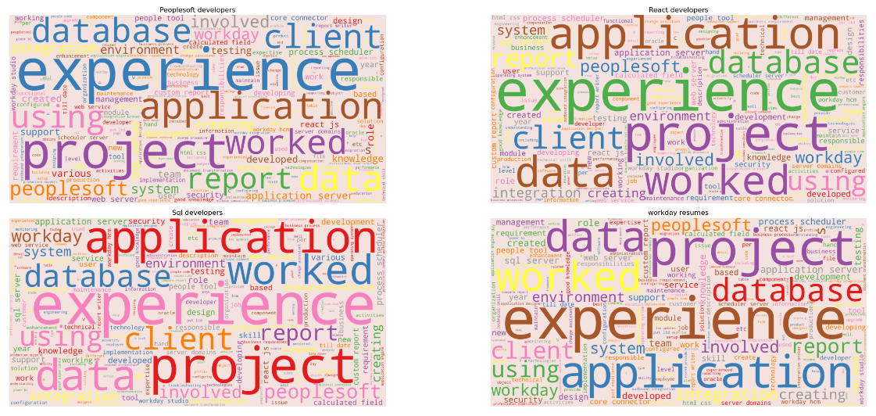
Word cloud for Each Category of Resume

Slide 12
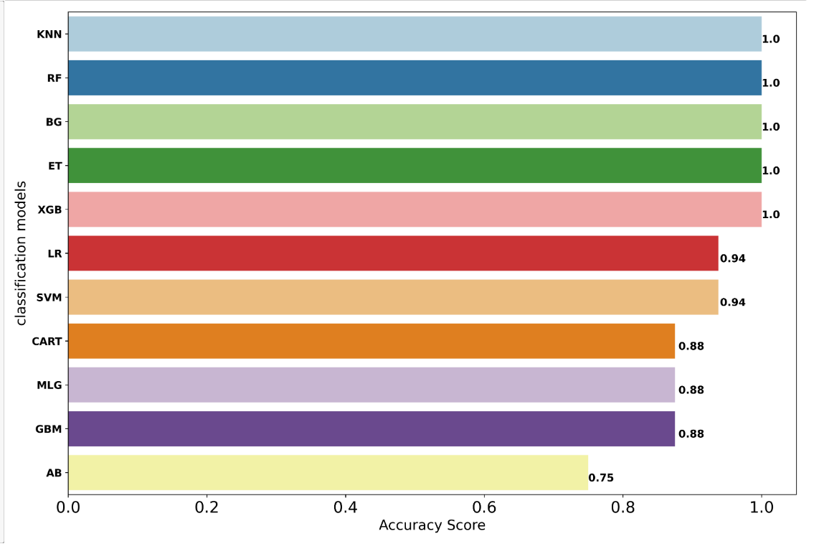
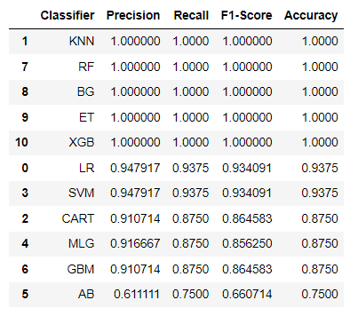
Model Building With classification algorithms

Slide 13
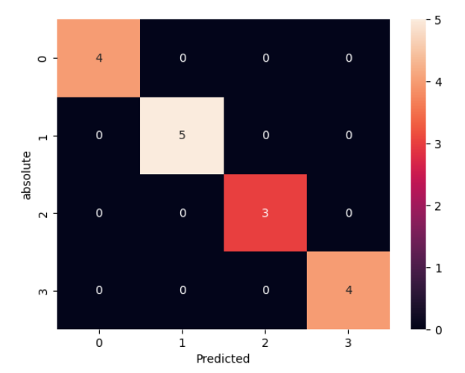
Model Evaluation and Predictions With optimal algorithms
After observation of report with all classification models and ensemble techniques we observed the best accuracy with random forest as our training and test data is neither overfitting or underfitting and also with the confusion matrix we observe that the misclassification is lesser

Slide 14
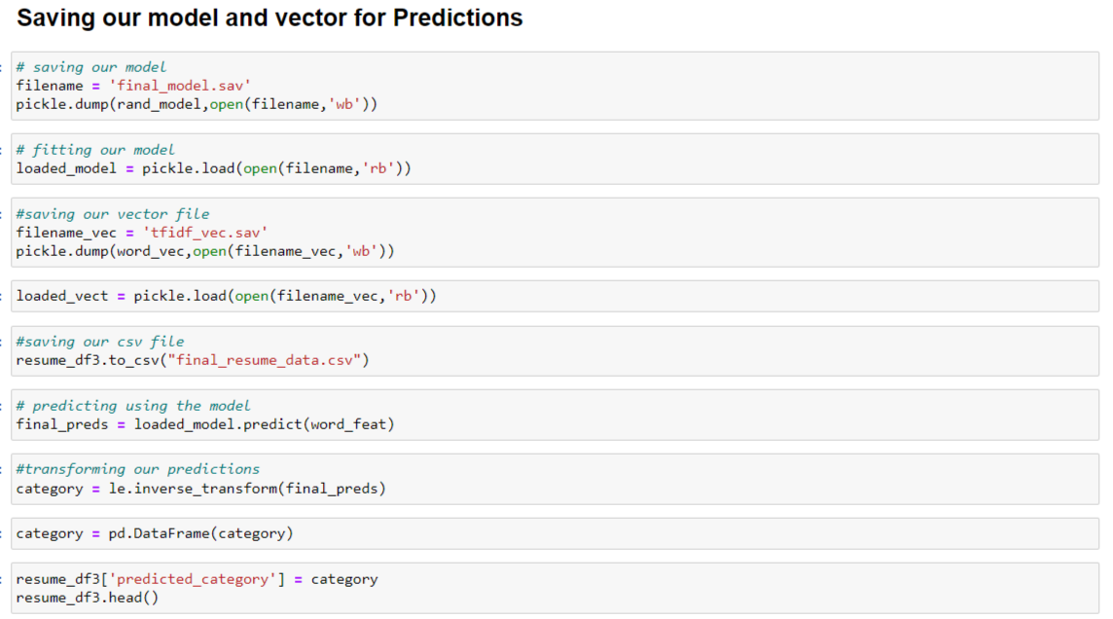

Slide 15
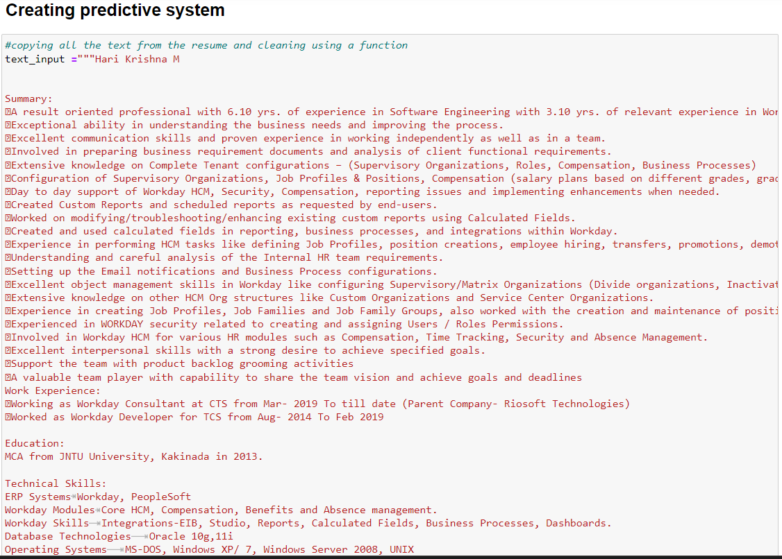

Slide 16
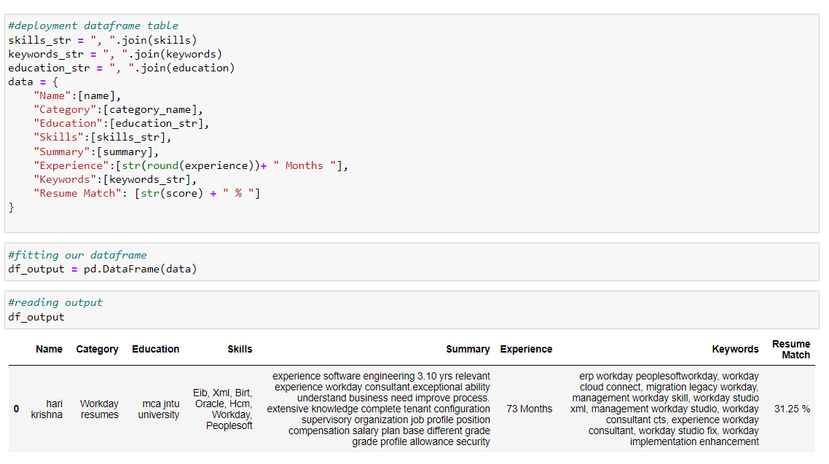

Slide 17
Project Conclusion
In this project we have worked on resume classification, we were given resumes of different categories. Our goal was to classify resumes according to their categories and extract information from the resume through screening.
We have performed necessary data exploration, text preprocessing, text visualization, feature extraction using count vectorizer, bag of words and explored different entities in the text using Named Entity Recognition
Using the spacy library we have found the most common words occuring in the corpus, built wordclouds for the whole corpus and particular category from the corpus, we observed the top 10 most occuring words in corpus constituting bigrams and trigrams.
After complete pipeline of Data exploration we initiated model building by encoding our category labels using label encoder,after encoding we have converted our data into vectors using TFIDF Vectorizer creating a sparse matrix.
we split our resume data into train and test data with ratio 80:20,80% as training set and 20% as test set,with this we are ready to train our model.
After splitting the data we have performed model training with classification algorithms and ensemble techniques ,using metrics like KFOLD- validation, confusion Matrix, classification report and accuracy score, we append all our categories of algorithms all at once.
After observing the confusion matrix and classification report we observed that Random Forest handled well by giving the least missclassification and a excellent equivivalent accuracy with training and testing validation. we got a good score of 1 for precision, recall, F1- score and accuracy.
after performing the evaluation matrix with optimal algorithms with selecting our random forest as final model we performed our predictions on our test data and we got final predictions and classified resumes according to their categories by mapping according to encoded labels.
after classifying resumes according to categories, we created a predictive system with resume parser techniques and extracted information from the input resume and fit in a dataframe.
To conclude resume classification or resume screening is a technique to reduce the human effort in human resource management and extract resume with higher level accuracy, In this project we found out the importance of resume screening and how well an ATS system functions.

Slide 18
Thank You

